Slide 1

ENSE 271 Group B Hi-Fidelity Prototype
Dr. Tim Maciag
University of Regina
Abdulrahman Khawaja, Amr Azouz, Pranil Thapa, Lorenzo Butalid

Slide 2
Agenda
Agenda 01
Agenda 02
Agenda 03
Agenda 04
Speaker: Amr Azouz Topic: Introduction & Home Page
Speaker: Pranish Thapa Topic: Fundraising & Granting
Speaker: AbdulRahman Khawaja Topic: Marketing
Speaker: Lorenzo Butalid Topic: Storytelling & Operations

Slide 3
Introduction
Northstar Customer: Charities
Goal: Provide a delightful experience
Used some techniques such as affordances to make program more user-friendly

Slide 4
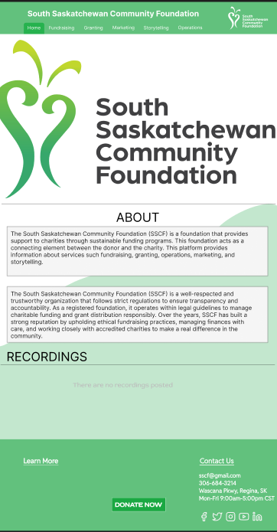
Home Page
Customer’s Notes: 1. Recordings under each section
2. Basic Information 3.Signifiers

Slide 5
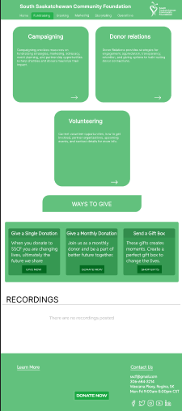
Fundraising
Providing information regarding fundraising.
Texting explaining what the button means
3. Recordings

Slide 6
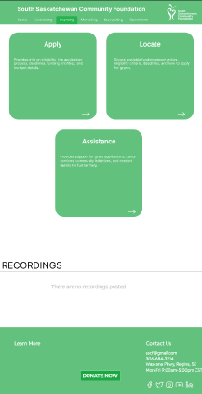
Granting
Text that helps user understand the meaning of the buttons
Recordings
Signifiers

Slide 7
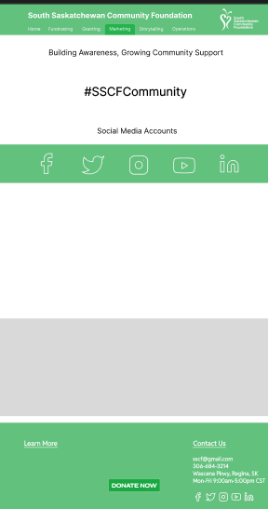
Marketing
1. Social Media icons with hyperlinks that direct the user to the SSCF online accounts

Slide 8
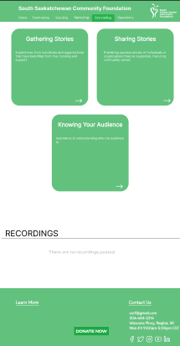
Storytelling
Signifiers
Recordings

Slide 9
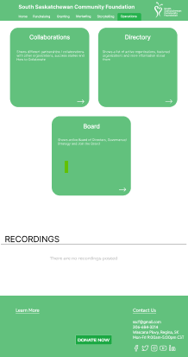
Operations
1. Combined the governance and operations buckets under one bucket 2. Signifiers 3. Recordings

Slide 10
Questionnaire
- How easy was it to navigate through the interface?
- How quickly did you become comfortable with the interface?
- Were any icons or symbols misleading?
- Did you find the colors and contrast comfortable for viewing?
- Were the font size and button size appropriate?
- What improvements or changes would you suggest?
- What did you like and dislike the most ?
- Any missing features you were expecting to see?
- On a scale of 1 to 10, how easy was it to navigate through the interface?
- Did you encounter any navigation issues? (Yes/No)
- Did you experience any readability issues due to color contrast? (Yes/No)
- How would you rate the font size? (Too small / Just right / Too large)
- How many improvements would you suggest? (0, 1-2, 3-5, More than 5)

